Slide 1
Green World Group Training Center

Slide 2
Green World Group
Green World Group is a world ‘s - Leading provider of health, safety, environmental, and quality management Training.
We offer courses accredited by certified UK boards like NEBOSH, IOSH, IRCA Lead Auditor Courses, RoSPA Accredited HSE Courses, National Diploma Courses in addition to that we have a collection of short Term courses.

Slide 3
Green World Group
GWG is a growth-oriented firm established in 2006 with safety as its primary objective.

Slide 4
Green World Group
We have been in the ever growing field of safety auditing, health safety, risk assessment, and recruitment and provide both occupational and workplace-based safety courses

Slide 5
Green World Group
we provide ‘State-of-the-art’ facilities across 7 global regions include, India, Middle East and African continents.

Slide 6
Green World Group
Think Green World Group !
Green World Group is a thriving and distinguished certified body offering globally recognized quality courses on International Health and Safety. Our organization has a huge portfolio of customized learning models and health and safety courses that cater to specific training and consulting needs.

Slide 7
Green World Group
Why Green World Group ?
Green World Group has achieved phenomenal success in delivering quality health and safety training and Environmental Management Consultancy programs to make the world a safer and sustainable place to live. We deliver excellence by providing:
International Quality Standards
High-Grade Exam Results
Dedicated panel of specialist trainers.

Slide 8
Green World Group
Why Green World Group ?
Green World Group has achieved phenomenal success in delivering quality health and safety training and Environmental Management Consultancy programs to make the world a safer and sustainable place to live. We deliver excellence by providing:
International Quality Standards
High-Grade Exam Results
Dedicated panel of specialist trainers.

Slide 9
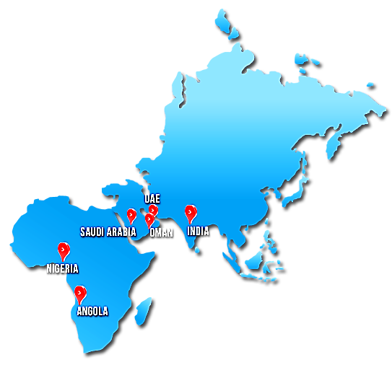
Green World Group
Our Global Reach

India
Chennai, New Delhi, Mumbai, Kolkata,, Hyderabad, Kerala
Saudi Arabia
Jubail , Dammam
Nigeria
Warri
UAE
Dubai , Abu Dhabi
Angola
Luanda Sul

Slide 10
Accredited courses
&
Training programmes
NEBOSH IGC
RoSPA Courses
IOSH
HAZWOPERM
TRAINING
COURSES
IRCA Lead Auditor
NATIONAL DIPLOMA
NEBOSH INTERNATIONAL DIPLOMA

Slide 11
Green World Group
NEBOSH International Diploma
The Diploma is designed to provide students with specialist knowledge combined with the application in health & safety skills, required to undertake their career as a safety and health practitioner.
Training Courses

Slide 12
Green World Group
NEBOSH International General Certificate
The NEBOSH International General Certificate in Occupational Health and Safety is a globally recognized qualification. The qualification focuses on international standards and management systems, enabling candidates to effectively discharge workplace health and safety responsibilities in any employment sector.
Training Courses

Slide 13
Green World Group
NEBOSH OIL & GAS
This qualification is Purposely design for Technical qualification seekers in the Filed of Oil and gas , which enables students to effectively discharge workplace safety responsibility both onshore as well as offshore.
Training Courses

Slide 14
Green World Group
NEBOSH Health & Safety at Work
The NEBOSH Award in Health and Safety at Work provides a good basic understanding of health and safety and is ideal for individuals wanting a solid introduction to the subject, as well as organizations wanting to improve their safety culture. It will equip your workforce to identify and deal with hazards at work, helping to reduce accidents and achieving cost savings for the business.
This qualification is an ideal first step towards other higher level NEBOSH qualifications including NEBOSH’s International General Certificate and National General Certificate.
Training Courses

Slide 15
Green World Group
IOSH Managing Safely
The course aims to ensure that safety requirements are appreciated by people employed as line managers, and to enable them to review their own departmental systems for safety, introducing new controls or implementing changes as appropriate to ensure safety in the workplace.
Training Courses

Slide 16
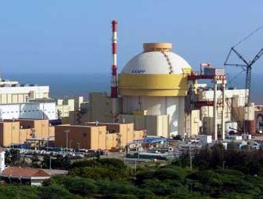
Green World Group
POST DIPLOMA IN POWER PLANT ENGINEERING, SAFETY & TECHNOLOGY [ IAEA Standard ]
In this course, students explore the engineering design of nuclear power plants using the basic principles of reactor physics, thermodynamics, fluid flow and heat transfer.
The purpose of this qualification is to disseminate lessons learned information regarding training and human resource considerations for commissioning of nuclear power plants (NPPs).The IAEA technical working group on training and qualification of nuclear power plant personnel. Subject cover the experiences gained regarding commissioning training for nuclear power plant projects.

Slide 17
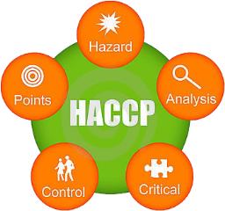
Green World Group
POST DIPLOMA IN HAZARD ANALYSIS CRITICAL CONTROL POINT [HACCP - ISO 22000 Standards]
This qualification is aimed at learners who are working at a management level in a manufacturing business, quality assurance staff or members of a HACCP team.
Achievement of this qualification gives learners the skills to assist in the implementation of a HACCP system, to critically evaluate HACCP plans and to understand the importance of having an effective HACCP system in place.

Slide 18
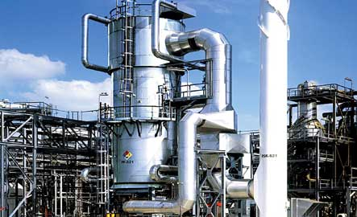
Green World Group
Post Diploma in Petro Chemical Process Safety & Engineering
Diploma in Industrial Safety is a program initiated by the Government of India. The main objective of this programme is to enhance knowledge, skills and improving the standard of health of the employees, monitoring the operating systems and bolstering the safety measures of an industry in general.
Training Courses

Slide 19
Green World Group
Advanced Diploma in Chemical Plant Processing Safety & Management
Diploma in Industrial Safety is a program initiated by the Government of India. The main objective of this programme is to enhance knowledge, skills and improving the standard of health of the employees, monitoring the operating systems and bolstering the safety measures of an industry in general.
Training Courses

Slide 20
Green World Group
Advanced Diploma in Occupational Safety, Health, and Environmental Management
ADOHSEM aims to enhance the skills, aptitude, and technical knowledge of the candidates with a course content that is tailored-made to suit industry-specific requirements. Staff of an organization is educated on industrial health, work hygiene, and accidental prevention techniques. Creating awareness when it comes to safety audits and health and safety management is critical, which is the main focus of ADOSHEM.

Slide 21
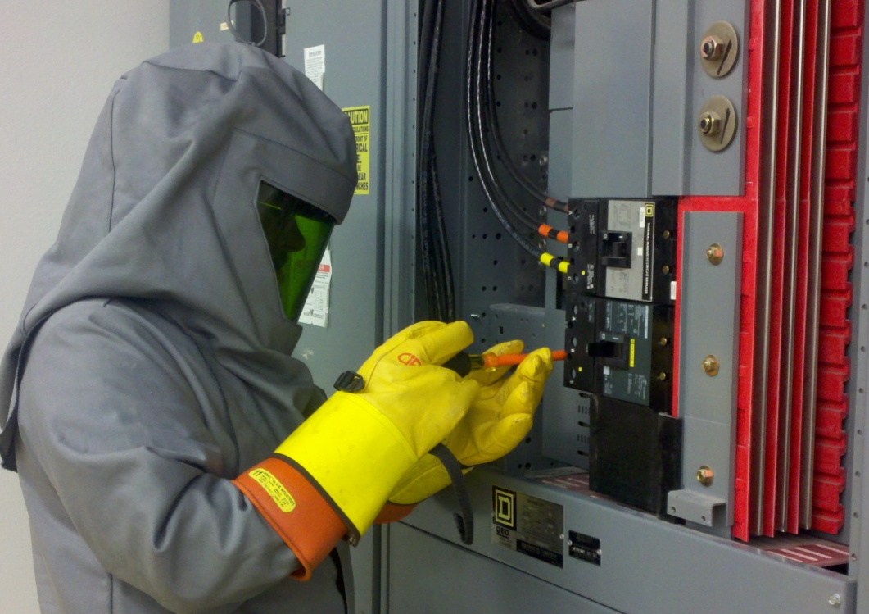
Green World Group
Diploma in Electrical Safety
This course emphasizes on the various regulations and practices for electrical safety. It provides best international management practices for the safe handling operations of personnel working in generation, transmission and dealing with power distribution issues. And it is intended for the electricity generating, power transmission and distribution sectors.
Training Courses

Slide 22
Green World Group
Diploma in Food Safety
The Diploma in Food Safety certification is ideal for managers and supervisors working in food or drink manufacturing and processing environments, quality control members of Hazard Analysis and Critical Control Point (HACCP) team or management level employees with manufacturing business. For students who are aiming to become food safety experts can join this course to learn the nuances of food safety and other international and national safety and health standards. The training program makes the participants understand the importance of following and implementation of HACCP system in the manufacturing environment.

Slide 23
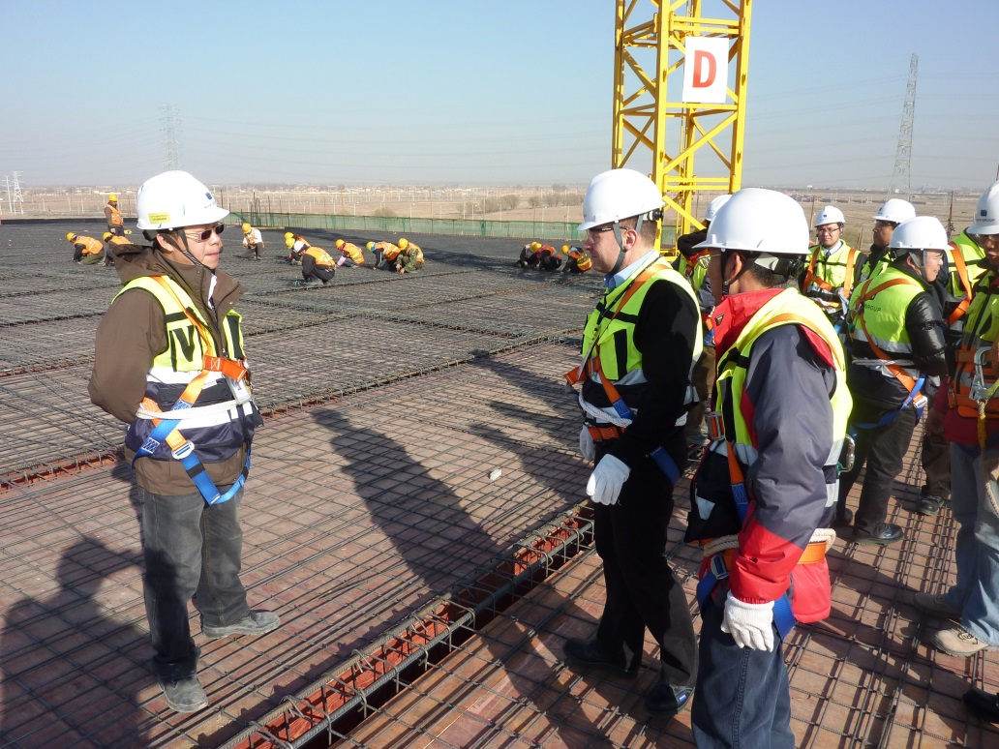
Green World Group
Diploma in Construction Safety
Construction Safety Diploma covers the main legal requirements relating to health and safety in international construction work, identification and control of construction workplace hazards, and the practical application of this knowledge.

Slide 24
Green World Group
Diploma in Fire Engineering and Safety Management
This course has been designed to enable individuals to demonstrate a wide range of critical knowledge and understanding relevant to a number of fire professional roles such as Fire Watch Manager in the Fire and Rescue Service Dept, Fire Safety specialist and Fire Investigation specialist. It focuses on the understanding of fire engineering science and safety that individuals need in order to assess buildings and to respond to diverse hazards and incidents.
Training Courses

Slide 25
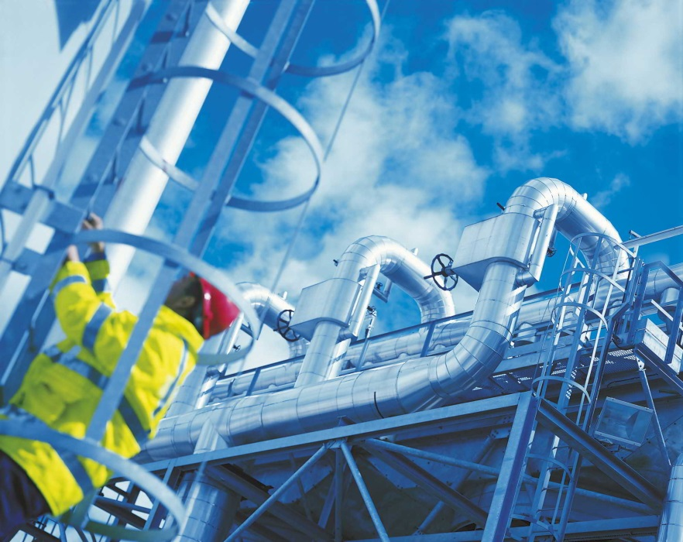
Green World Group
Diploma in Industrial Safety
The main objective of this programme is to enhance knowledge, skills and awareness among the students in the field of Industrial related safety, health and environment. Diploma in Industrial Safety aims at minimizing the chances of risks, injuries and accidents by implementing Risk management techniques and safety management operations, improving the standard of health of the employees, monitoring the operating systems and bolstering the safety measures of an industry in general.

Slide 26
Green World Group
Diploma in Offshore Safety
This course deals with Occupational Safety issues associated with Offshore work activity. The training content and curriculum is exclusively designed to ensure that it can be followed and understood by people from across countries and by staff at different levels of their career. This course will bring you an insight on topics like Basic Safety Engineering, Occupational Health and Safety, Fire Prevention and Safety, offshore Safety. Diploma in Offshore Safety is a specialist qualification for people in offshore oil and gas industry who are responsible for ensuring safety as part of their day to day duties.

Slide 27
Green World Group
Diploma in Environmental Safety
Diploma in Environmental Safety Engineering is the comprehensive Safety Management Program related to Industries which are prone to Environmental Pollution. The training program educates the participants of the relevant responsibilities a safety officer has to shoulder in the working environments involving hazardous wastes. The course also provides the students with the latest know-how and technology on environment engineering and hazardous waste operation systems.
Training Courses

Slide 28
Green World Group
Master Diploma in Occupational Health, Safety, Environment & Risk Management
Masters Diploma program is a qualification for aspiring health and safety professionals which has been designed to provide students with the expertise required to undertake a career as a safety and health practitioner and also provides a sound basis for progression to postgraduate study in the similar field or other competent industries.
Training Courses

Slide 29
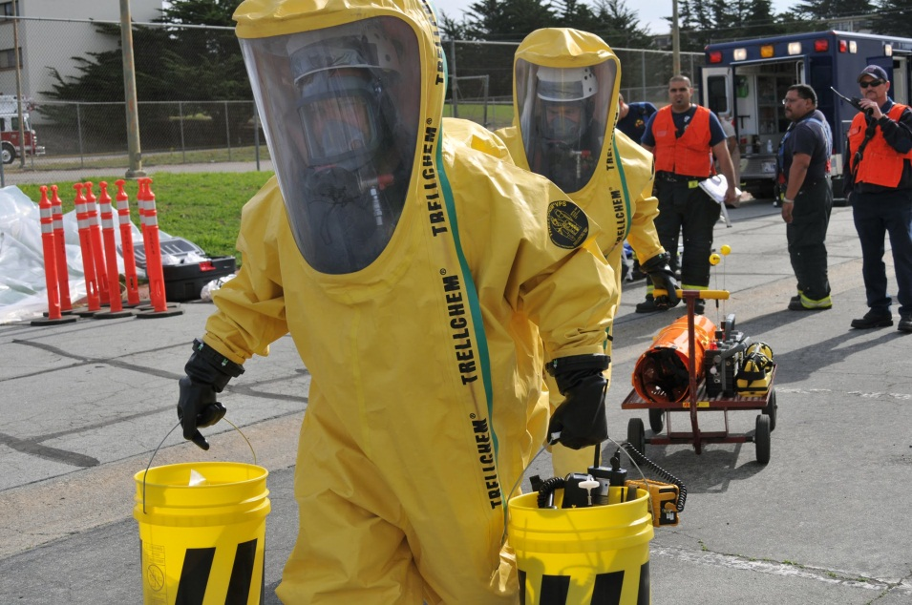
Green World Group
Hazardous Waste Operations and Emergency Response Management
The HAZWOPERM – 30 hour online program is designed to understand the methodologies in a in clean-up operation, voluntary clean-up operations as a control measure, emergency response operations, and storage, disposal, or treatment of hazardous substances or uncontrolled hazardous waste sites and management of the same in an effective manner.
Training Courses

Slide 30
Green World Group
Green World Group expands its horizons by offering a new range of e-Learning courses in partnership with Human Focus International; all courses are accredited by RoSPA. Courses aimed at providing individuals with an overview of key health and safety topics. Whether you are looking to gain important health and safety skills, or refresh previously gained knowledge..
Courses:
Fire safety
First Aid Awareness
Accident Investigation
Training Courses

Slide 31
Green World Group
Fire Safety
This course takes a brief look at the general principles of fire safety and what to do in the event of a fire.
This course will aim to give you an overview of Fire Safety, and what to do in the case that a fire should break out in your workplace.

Slide 32
Green World Group
First Aid Awareness
First Aid is essential for the immediate treatments of accidents before help from the emergency services arrive. Taking this course could really mean the difference between life and death and help minimize the severity of an injury. The objective of the course is to ensure that an individual is aware of basic first aid techniques until a qualified First Aider arrives at the scene.

Slide 33
Green World Group
Accident Investigation
Thorough investigation into any workplace accident is necessary to help prevent recurrences. The Accident Investigation course will give you a broad understanding of the accident investigation process and its benefits. This course will equip your employees with the essential knowledge, skills and tools to conduct investigation and prevent costly recurrences.

Slide 34
Green World Group
IRCA Lead Auditing Course
IRCA certified training can help candidates to demonstrate their competence as an auditor and go on to achieve professional recognition as an IRCA certified lead auditor.
Training Courses

Slide 35
Green World Group
Welcome to The In-House Training Company. We work across the country.
The cost protecting benefits of offering Training In-House can be so great, reducing employee travel time, travel expenses and time away from your employees tasks at hand, most organizations find the choice of offering training on-site is the most effective way to get in touch with an even greater number of employees without the involved time and money.

Slide 36
Green World Group
Trainers Profile
Our trainer profiles range from a vast working experience in the field of Oil & Gas, Airline industry, and corporate oil giants in the likes of Shell, BP, SBM Offshore.
Trainers Nationality
Indian, Pakistani, Saudi Arabians

Slide 37
Green World Group
Our Clients

Slide 38
Green World Group
Our Clients

Slide 39
Green World Group
The quality services of Green World Group in the health and safety domain have always been well received by our clients, who belong to different sectors of the industry.
UAE
India
Angola
Saudi Arabia
Nigeria

Slide 40
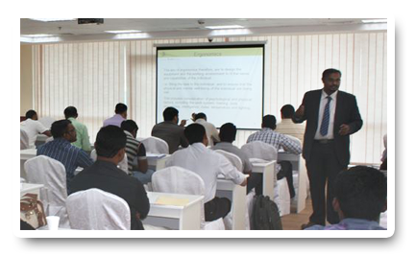
Image
Business Centers
Green World Group
Green World Mgmt & Training Institute
# 5/12 Ambalavanar Street, 100 feet road, Arumbakkam, Chennai – 600 106 Land Mark: Next to Hotel Vijay Park, Tel: 044 24750740.
Mobile: +91 8098498158
Toll-Free: 1800 300 20676
WhatsApp: +91 9791082789

Slide 41
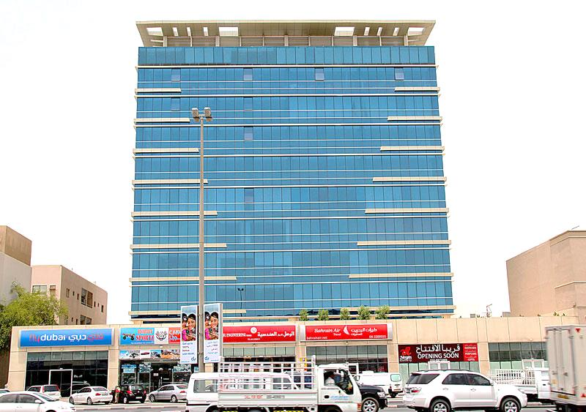
Business Centers
Image
Green World Group
Green World Safety and Security Consultancy LLC
Suite #102, First Floor, Sapphire Tower, Near Dnata, Deira, Dubai PO Box -83127 Tel: +971-04-2698807
Mobile: +971-055-7044902
WhatsApp: +971 557044902

Slide 42
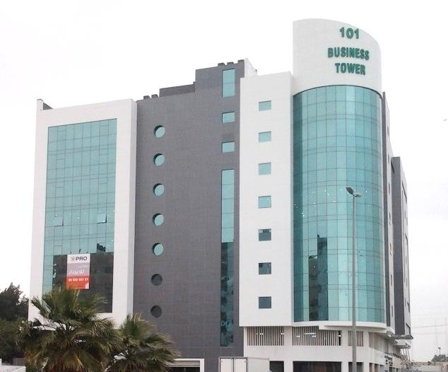
Image
Business Centers
Green World Group
Green World Group
Green World Group Training Center
Office # 613, Business Tower #101 King Abdul-Aziz Street , Jubail city. Kingdom of Saudi Arabia. Tel: +966 13 3638442.
Mobile: +966 50 5744304.
WhatsApp: +966 50 5744304

Slide 43
THANK YOU….
Visit Us
www.greenwgroup.com
www.greenwgroup.ae
www.greenworldsaudi.com
www.greenwgroup.co.in
www.greenwgroup.org

